Slide 1
Automated Customer Reviews
G2
Rodrigo Torallba
Sohail Hiraj

Slide 2
Introduction
Develop a product review system powered by NLP models
Classifying reviews, Clustering product categories and
using generative AI to summarize reviews into recommendation articles.

Slide 3
Summary and Preprocessing
Classification with Distilbert Model
Clustering was done with TfidfVectorizer + Kmeans
Summarization with Mistral-7b and Fine-tunning with Qlora
Deployment --> Loveable website
Cleaned the data by Merging datasets, reducing columns,
removing duplicate values, and adding some stopwords

Slide 4
Classification model
Classify customer reviews into positive, negative, or neutral categories
We tried two fine-tunned distilbert model
Accuracy : 0.9608
Precision: 0.9593
Recall : 0.9608
F1-score : 0.9600

Slide 5
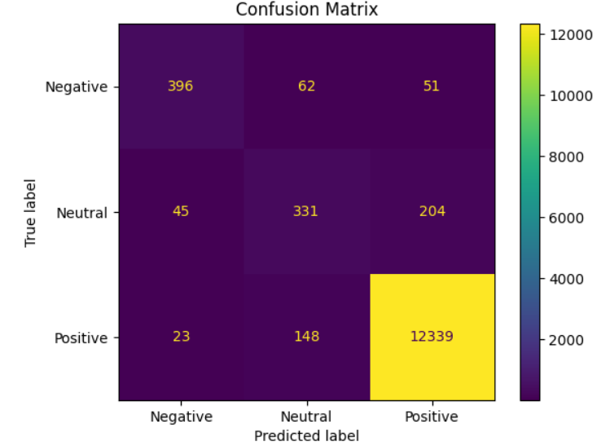
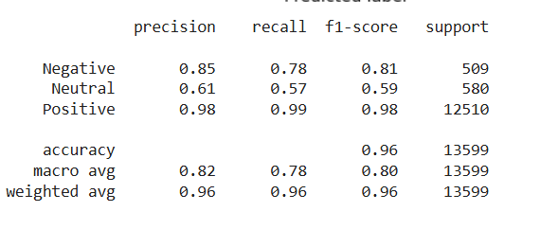
Model 1 - Evaluation
Classify customer reviews into positive, negative, or neutral categories to help the company improve its products and services.
Accuracy = 0.96, F1-score 0.79

Slide 6
Clustering Model
TfidfVectorizer + Kmeans
We cluster the products into 3 categories
Cluster 0 : Audio Devices
Cluster 1: Power & Batteries
Cluster 2: Ebook Readers & Tablets",

Slide 7
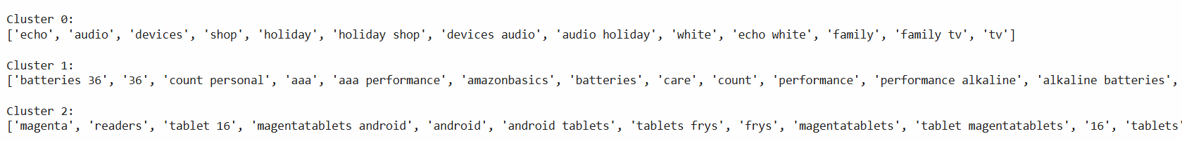
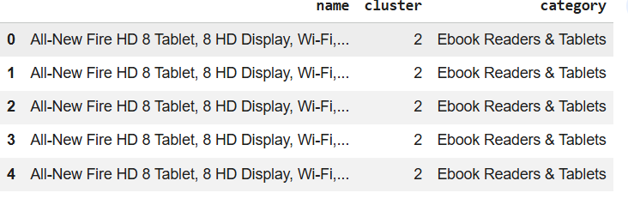
Model 2 - Evaluation

Slide 8
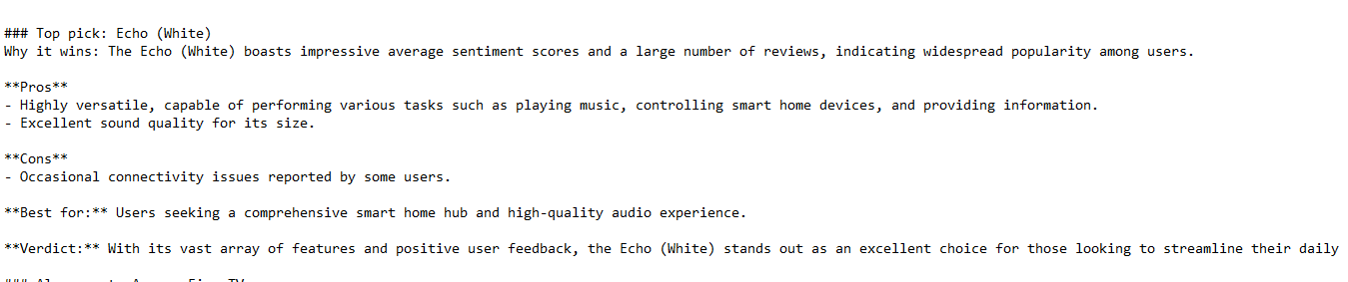
Summarization Text model
Use Generative AI to summarize reviews into an article which recommends the top products for each category
Mistral-7b and fine-tunning with QLoRa

Slide 9
Deployment
URL: https://review-spark-compare.lovable.app

Slide 10
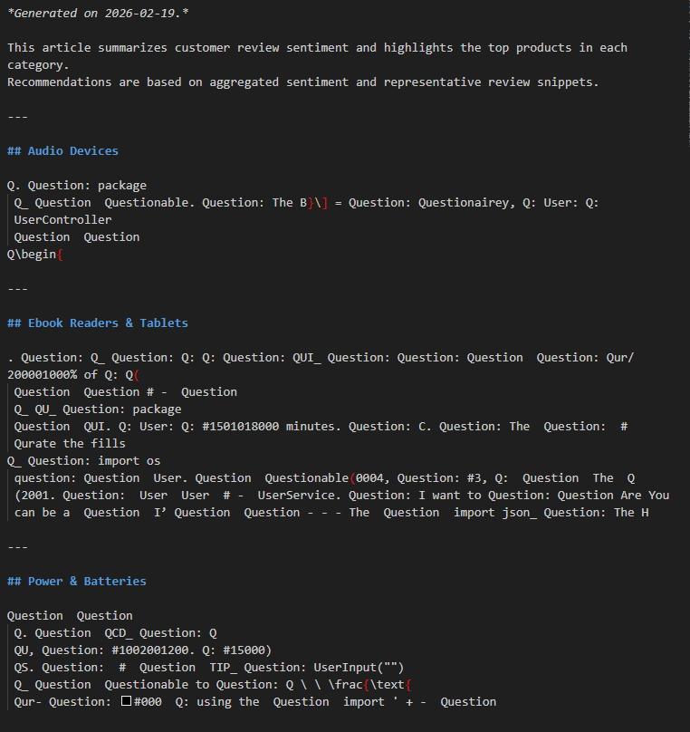

Self Medal: LSD Medal
Because of my model was hallucinating
so hard it looked like it was high on LSD.

